Slide 1
Uber Supply – Demand Gap
BY : - Pankaj Kumar Mahato

Slide 2
Bussiness Objective
To identify the root cause of problems of cancellation of request and non availability of cabs and recommend suggestions to tackle the problem.

Slide 3
Data Used For Analysis
The data used is only to and fromairport.
The span of the data is of 5 days.

Slide 4
Data Collection And Cleaning
Identifying the data quality issues and clean the data
Format date and time variables
Extract new variables required for analysis

Slide 5
Data Set Contains 6 Columns
6 attributes provided for in the csv file:
1) request id-id of the request made. Unique in nature.
2) pickup point-location from where the request is being made.
3) driver id-unique id of the driver.
4) status –status of request i.E whether its been completed, cancelled or the cab is not available.
5) request timestamp-date and time of the request.
6) drop timestamp-date and time of completion of request.

Slide 6
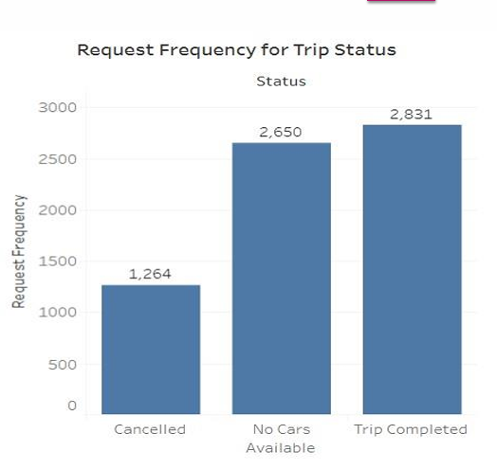
Analysing Trends For Completion Of Trips
We can clearly see from this plot that Uber is losing quite a lot of business due to shortage of available Cabs. Viewing the frequency of request with their status shows us the above the figure. It is clear that most of the failed request are due to no cars being available at that moment. Still further analysis is need to give a concrete conclusion and the cause for this

Slide 7
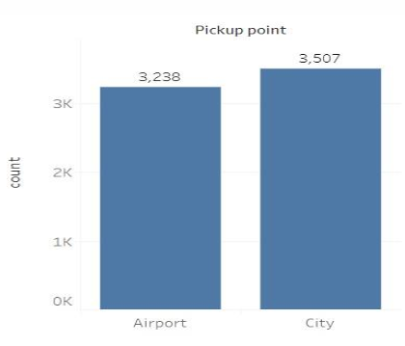
Request At Each Pickup Point.
From above plot it can be seen that there are two pickup points Airport and City. They have almost equal request however city have slightly more requests than airport.

Slide 8
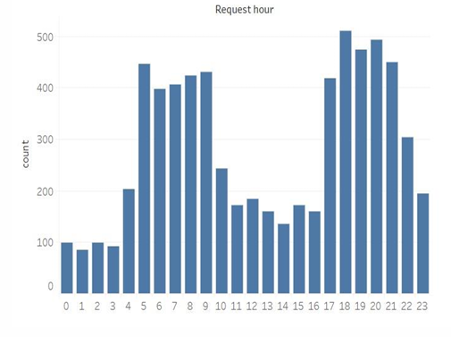
Combining Data For Hour Demand Analysis
The plots between frequency of requests and hour tells us that maximum request are been made in morning and evening from 5 am-10 am and from 5 pm -10 pm.

Slide 9
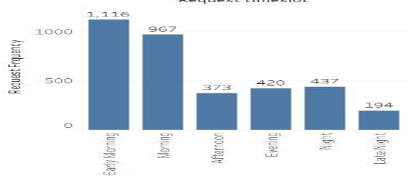
Number Of Request With Timeslot
As seen in graph that the no of request is high at early morning and evening.

Slide 10
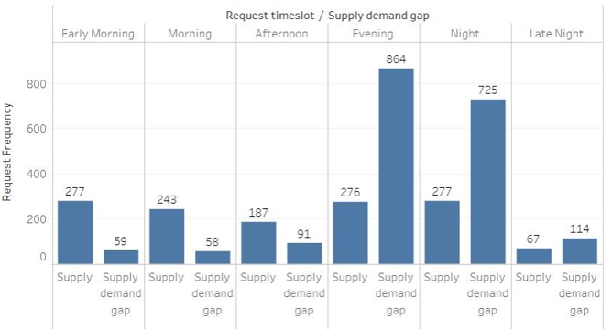
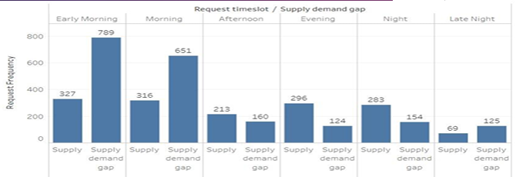
Let Us See Supply And Supply Demandgapat Both Pickup Point

Slide 11
Conclusion
There is a huge gap in supply and demand. IN GENERAL, THE SUPPLY AND DEMAND HAVE conclusion: A GAP.
There are a lot of rides which go incomplete (unavailable or cancelled) in comparison to being completed.
Irrespective of how we consider the data, the lag is greater than the supply.
In fact, the lag goes further down during peak hours but is still less than the completed/supplied trips.
In other words, the supply-demand gap is clear.
It can be fixed perhaps, by focusing more on the peak hours first as they contribute in extra to the already existing gap.
That should be the place to start.

Slide 12
Analysis Conclusion
PICKUP POINT: CITY
PICKUP POINT: AIRPORT
As per above plots, the morning time slot show the greatest negative gap and it is problematic due to requests are being cancelled. Reason behind request cancellation could be morning rush. It can be considered that most probably drives cancelled the request for airport as they can get many rides within the city instead of single airport ride.
As per above plots, the evening time slot show the greatest negative gap and it is problematic due to no cars available. Reason behind no cars available could be due to not enough cars are available as cars might not be in the airport area due they are in the city and some of the drivers might have gone to home.

Slide 13
Recommendations
Based on the performed analysis of data, there are some recommendations which can be used by uber to bridge the gap between supply and demand.
For airport to city, an uber stand can be created at airport where cabs will available all the time, this will itself lower down the no cars available status.
For city to airport, uber can give some small reward or something to the drives in the morning. This might attract drivers to go for airport, this step can be helpful in reducing the number of cancellation during morning time for airport.
There should be a threshold for cancelling a ride in a day ad some sort of penalty should be imposed.
There is definitely need of more cars for filling the gap.

Slide 14


